Slide 1

The Magic Behind Database.com:
Automation in the Cloud
Rob Woollen
rwoollen@salesforce.com

Slide 2
Safe Harbor
Safe harbor statement under the Private Securities Litigation Reform Act of 1995: This presentation may contain forward-looking statements that involve risks, uncertainties, and assumptions. If any such uncertainties materialize or if any of the assumptions proves incorrect, the results of salesforce.com, inc. could differ materially from the results expressed or implied by the forward-looking statements we make. All statements other than statements of historical fact could be deemed forward-looking, including any projections of subscriber growth, earnings, revenues, or other financial items and any statements regarding strategies or plans of management for future operations, statements of belief, any statements concerning new, planned, or upgraded services or technology developments and customer contracts or use of our services.
The risks and uncertainties referred to above include – but are not limited to – risks associated with developing and delivering new functionality for our service, our new business model, our past operating losses, possible fluctuations in our operating results and rate of growth, interruptions or delays in our Web hosting, breach of our security measures, the outcome of intellectual property and other litigation, risks associated with possible mergers and acquisitions, the immature market in which we operate, our relatively limited operating history, our ability to expand, retain, and motivate our employees and manage our growth, new releases of our service and successful customer deployment, our limited history reselling non-salesforce.com products, and utilization and selling to larger enterprise customers. Further information on potential factors that could affect the financial results of salesforce.com, inc. is included in our annual report on Form 10-K for the most recent fiscal year ended January 31, 2010. This documents and others are available on the SEC Filings section of the Investor Information section of our Web site.
Any unreleased services or features referenced in this or other press releases or public statements are not currently available and may not be delivered on time or at all. Customers who purchase our services should make the purchase decisions based upon features that are currently available. Salesforce.com, inc. assumes no obligation and does not intend to update these forward-looking statements.

Slide 3
Agenda
Salesforce.com Cloud Services
Site Architecture
Self Optimizing Database
Automatic Resource Management
Automatic Quality

Slide 4
Agenda
Salesforce.com Cloud Services
Site Architecture
Self Optimizing Database
Automatic Resource Management
Automatic Quality

Slide 5


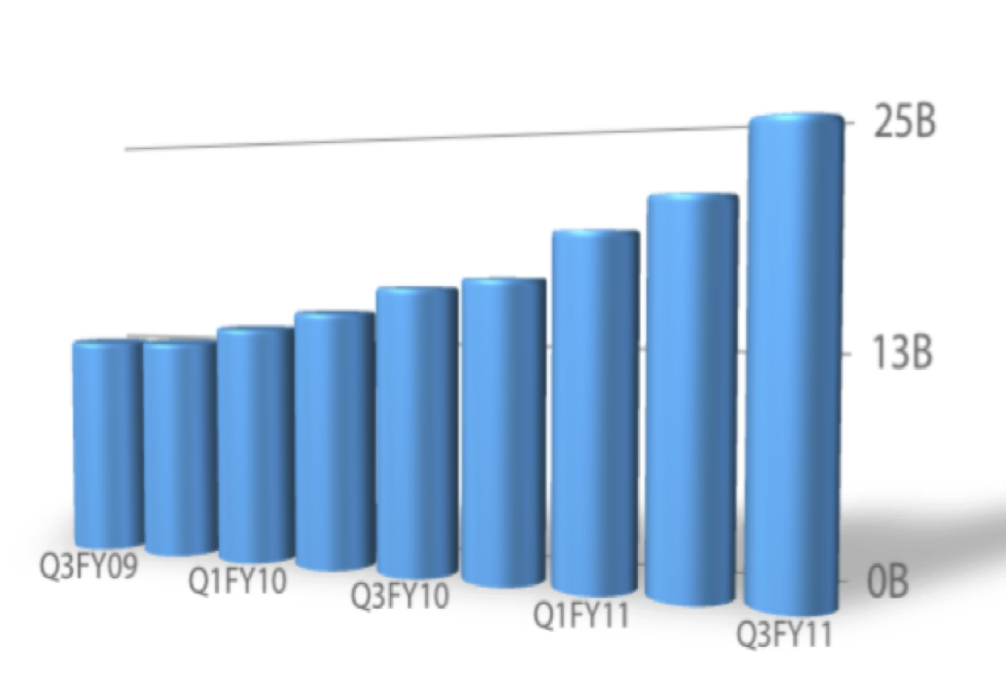














Force.com is the Proven PaaS Leader
Proven Success
Proven Adoption
Proven Service
185,000+ Custom Apps
450+ M transactions / day
~1 million database tables
20+ billion rows of data managed
11 year track record
ISO 27001 and SysTrust
SAS 70 Type II
Automatic Backup and Disaster recovery
“Salesforce.com emerges as the PaaS leader for professional developer tools.”

Slide 6




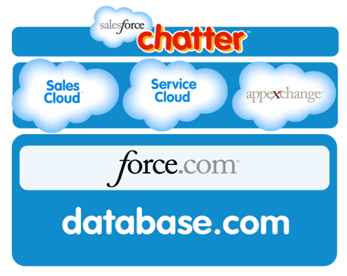







Force.com: Open Platform for Building Enterprise Apps
Fastest path to departmental apps
Fastest path to
marketing websites
Fastest path to
enterprise java apps
Fastest path to
Ruby Apps

Slide 7














Cloud Services
Content Management
Mobile
OLTP
Packaging
SOQL
Query
API Access to Data & Metadata
Search
Business Intelligence / OLAP
Batch Processing
Multi-tenant programming language (Apex)
Web MVC Framework (Visualforce)
BPM (workflows, approvals)
Notes:
OLTP
Create “Tables”, “Columns” (Custom Objects / Fields)
Query with SOQL (Salesforce Object Query Language)
Declarative and API access to Data and Metadata
Business Intelligence / OLAP
Real-time Analytics (reports / dashboards)
Application Server
Multi-tenant Programming Language (Apex)
Web MVC Framework (Visualforce Pages)
BPM
Workflows / Approval Processes
Batch Services
Scheduled / Batch Apex Code
Packaging
Installable cloud applications
Search
Content Management
Mobile
And many, many more!
7

Slide 8
Agenda
Salesforce.com Cloud Services
Site Architecture
Self Optimizing Database
Automatic Resource Management
Automatic Quality

Slide 9
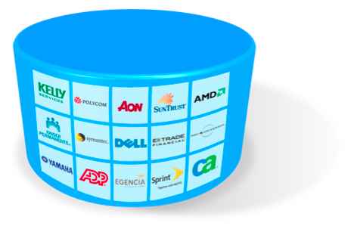
Site Architecture Overview
Tenants (e.g., a company) known as “organizations”
Each organization has users
  From 1 to 100,000s
  Each username maps to a single organization-id
Single code base
  Only 1 version to support!
680,000+ Custom Objects (Tables)
24 Production Instances
~8 DBAs

Slide 10
Physical Architecture
Scalable “Pod” Architecture
NA1
NA2
NA3
EMEA
AP
“n” Pod
Multi-tenant Clusters
Large Object Storage
Scalable Software Architecture:
Oracle Database servers
Resin Application servers
Lucene search servers
Linux and Redhat OS
SAN
Oracle RAC
Search
Indexers
Content Manage-ment
Java Application Servers
Load Balancers

Slide 11
Our religion:
Not all “multi-tenant” designs are created equal
“Can’t we create a separate stack for just this one customer?”
“I promise it’s just this one…”
App
Db
App
Db
Notes:
11
It’s a slippery slope, this is hard
Upgrade timing
Functionality for one tenant
Performance tuning for one tenant
UI for one tenant
Workflow for one tenant
Security concerns (real or perceived)
Has any other enterprise database application resisted this temptation?

Slide 12

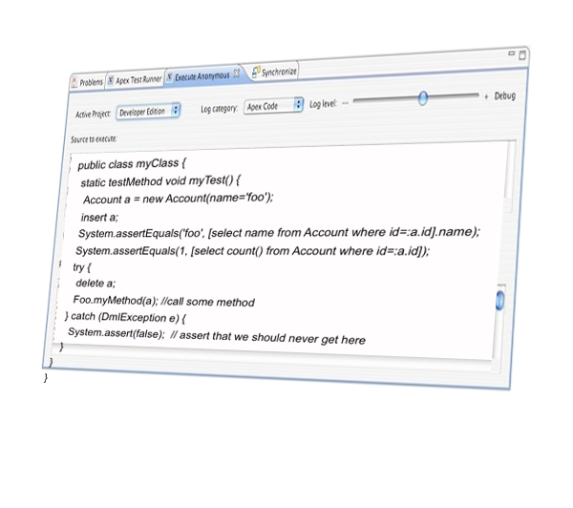
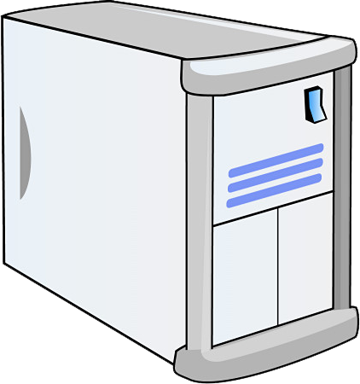

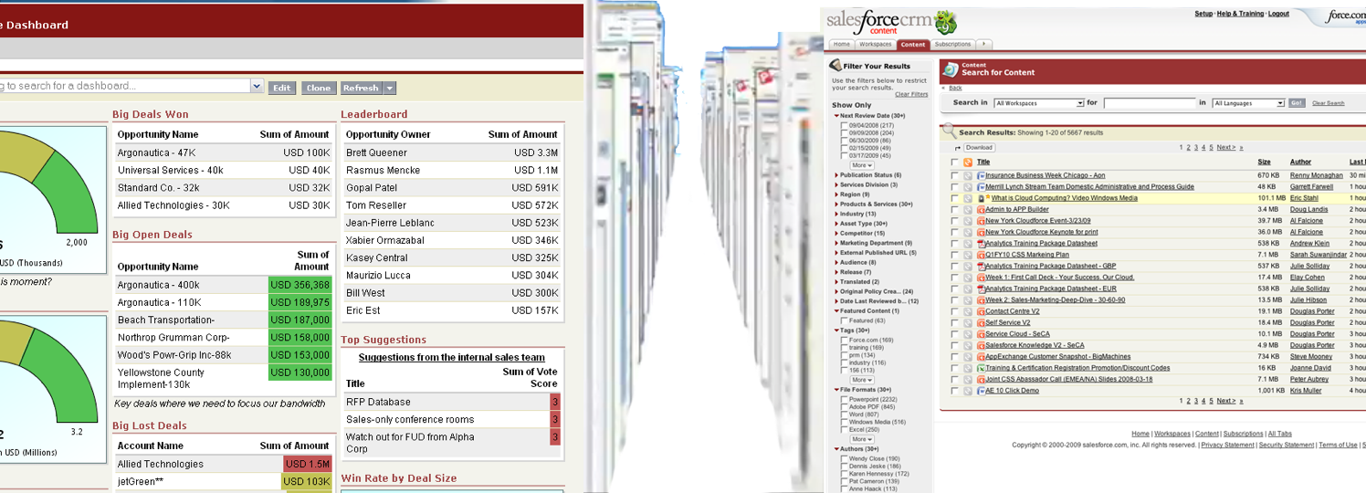
True Multi-tenancy: Why Share Everything?
~24 Databases
~2000 Servers
2 Mirrors
1 Code Base
100,000’s of Unique Applications

Slide 13
Agenda
Salesforce.com Cloud Services
Site Architecture
Self Optimizing Database
Automatic Resource Management
Automatic Quality

Slide 14


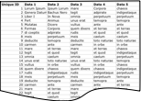
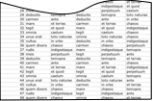

Sharing Relational Data Structures is Hard
Your Definitions
Your Data
Your Optimizations
Indexes
Pivot table for non-unique indexes
UniqueFields
Pivot table for unique indexes
Dell’s Products
Relationships
Pivot table for foreign keys
Harrah’s Data
MRUIndex
Pivot table for most-recently-used
FallBackIndex
Your Rep’s Data
Pivot table for Name field index
…others…

Slide 15
Flex Schema on Steroids: Everyone’s Data
Flex Column: Multiple Data Types
ID | Tenant | Data 2
1000001 | Harrah’s | $190
1000002 | Harrah’s | $250
1000003 | Harrah’s | $680
1000004 | Harrah’s | Poker
1000005 | Harrah’s | Black Jack
1000006 | Harrah’s | Craps
1000007 | Dell | Display
1000008 | Dell | Laptop
1000009 | Dell | Server

Slide 16
Flex Schema: Everyone’s Optimizations
Muti-Tenant Table
Multi-tenant Index
ID | Data 1 | Data 2
10002 | unus erat | toto naturae
10003 | vultus | in orbe
10004 | quem dixere | chaeos
10005 | rudis | indigestaque
10006 | meis | perpetuum
10007 | deducite | temopra
10008 | carmen | ante
10009 | mare | et terras
10010 | tegit | et quod
10011 | omnia | caelum
10012 | unus erat | toto naturae
10013 | vultus | in orbe
10014 | quem dixere | chaeos
10015 | rudis | indigestaque
10016 | meis | perpetuum
10017 | deducite | temopra
10018 | carmen | ante
10019 | mare | et terras
10020 | tegit | et quod
10021 | omnia | caelum
10022 | unus erat | toto naturae
10023 | vultus | in orbe
10024 | quem dixere | chaeos
10025 | rudis | indigestaque
10026 | meis | perpetuum
10027 | deducite | temopra
10028 | carmen | ante
10029 | mare | et terras
10030 | tegit | et quod
10031 | omnia | caelum
10032 | unus erat | toto naturae
10033 | vultus | in orbe
ID | Tenant | Data 2
1000001 | Harrah’s | $190
1000002 | Harrah’s | $250
1000003 | Harrah’s | $680
1000004 | Harrah’s | Poker
1000005 | Harrah’s | Black Jack
1000006 | Harrah’s | Craps
1000007 | Dell | Display
1000008 | Dell | Laptop
1000009 | Dell | Server
Tenant | Text | Number
Harrah’s |  | $190
Harrah’s |  | $250
Harrah’s |  | $680
Harrah’s | Poker
Harrah’s | Black Jack
Harrah’s | Craps
Dell | Display
Dell | Laptop
Dell | Server
Redundant
Storage
Notes:
Indexing a multi-tenant table is non-trivial due to (1) each flex column is varchar, (2) each flex column is shared by multiple tenants, (3) each tenant could have diff data type for that flex column
Solution:
Create a multi-tenant index
Define some “real” (native) data types like Text, Number and Date
Synchronously (within same transaction) propagate changes from multi-tenant table into the multi-tenant index
Create “normal”, non-unique indexes on the multi-tenant index table (TenantId+column#+native-data-type)

Slide 17

Multi-tenant Indexing
Long-running queries
returning a small # of rows
Index Recommendation Engine
Recommended Indexes
?
?
?
?
?
Currently, Salesforce admins must manually create the index
Automatic index creation is in development
?
?
?
?
?
?
?
analyzes filter selectivity
Notes:
We created something to analyze soql and recommend indexes.
We can drill in at Org level or at instance level.
We can measure possible usage, and usage after creation.
We manually create.
BUT We wanted to make it automatic so we have to get the creation on to a queue and then picked up and created (170).
This allows us to manage load, timebox it etc.
Now that is working we have a non human process (rather than a button press) to put on a queue.
We score them and we only create so many.
Indexes created automatically for schema constraints
Unique fields, foreign keys, external ids, …
Custom Indexes are not automatically created
Custom Index Recommender process monitors queries looking for long-running queries returning a small number of rows
Matching queries are recorded
Background process analyzes selectivity of filter
Currently this generates a report and salesforce admins must manually create the index
Automatic index creation is in development

Slide 18

A Real World Question
Michael Dell wants to know if Servers are selling well in the West
How will answer this question quickly?

Slide 19

Multi-tenant Query Optimizer
Go
Shared
Visibility
Shared
Indexes
Run pre-queries
Check user Visibility
User Visibility
=
# of rows that the user can access
ID | Data 1 | Data 2
10002 | unus erat | toto naturae
10003 | vultus | in orbe
10004 | quem dixere | chaeos
10005 | rudis | indigestaque
10006 | meis | perpetuum
10007 | deducite | temopra
10008 | carmen | ante
10009 | mare | et terras
10010 | tegit | et quod
10011 | omnia | caelum
10012 | unus erat | totonaturae
10013 | vultus | in orbe
10014 | quem dixere | chaeos
10015 | rudis | indigestaque
10016 | meis | perpetuum
10017 | deducite | temopra
10018 | carmen | ante
10019 | mare | et terras
10020 | tegit | et quod
10021 | omnia | caelum
10022 | unus erat | toto naturae
10023 | vultus | in orbe
10024 | quem dixere | chaeos
10025 | rudis | indigestaque
10026 | meis | perpetuum
10027 | deducite | temopra
10028 | carmen | ante
10029 | mare | et terras
10030 | tegit | et quod
10031 | omnia | caelum
10032 | unus erat | toto naturae
10033 | vultus | in orbe
ID | Data 1 | Data 2
10002 | unus erat | toto naturae
10003 | vultus | in orbe
10004 | quem dixere | chaeos
10005 | rudis | indigestaque
10006 | meis | perpetuum
10007 | deducite | temopra
10008 | carmen | ante
10009 | mare | et terras
10010 | tegit | et quod
10011 | omnia | caelum
10012 | unus erat | totonaturae
10013 | vultus | in orbe
10014 | quem dixere | chaeos
10015 | rudis | indigestaque
10016 | meis | perpetuum
10017 | deducite | temopra
10018 | carmen | ante
10019 | mare | et terras
10020 | tegit | et quod
10021 | omnia | caelum
10022 | unus erat | toto naturae
10023 | vultus | in orbe
10024 | quem dixere | chaeos
10025 | rudis | indigestaque
10026 | meis | perpetuum
10027 | deducite | temopra
10028 | carmen | ante
10029 | mare | et terras
10030 | tegit | et quod
10031 | omnia | caelum
10032 | unus erat | toto naturae
10033 | vultus | in orbe
Check filter selectivity
Multi-tenant Optimizer Statistics
Filter Selectivity
How specific
is this filter?
=
Write query-based on results of pre-queries
Execute query
Stop
Notes:
19
Multi-tenant optimization based on our flex schema with knowledge of de-normalized pivot tables and sharing model
Data sharing is scalable and robust and tightly integrated into the optimizer – another high-level application feature pushed into the DB layer
Statistics kept automatically for custom indexes and foreign keys
Histograms for picklist values, special statistics for record owner field, etc.

Slide 20
Multi-tenant Query Optimizer
Indexes
ID | Data 1 | Data 2
10002 | unus erat | toto naturae
10003 | vultus | in orbe
10004 | quem dixere | chaeos
10005 | rudis | indigestaque
10006 | meis | perpetuum
10007 | deducite | temopra
10008 | carmen | ante
10009 | mare | et terras
10010 | tegit | et quod
10011 | omnia | caelum
10012 | unus erat | totonaturae
10013 | vultus | in orbe
10014 | quem dixere | chaeos
10015 | rudis | indigestaque
10016 | meis | perpetuum
10017 | deducite | temopra
10018 | carmen | ante
10019 | mare | et terras
10020 | tegit | et quod
10021 | omnia | caelum
10022 | unus erat | toto naturae
10023 | vultus | in orbe
10024 | quem dixere | chaeos
10025 | rudis | indigestaque
10026 | meis | perpetuum
10027 | deducite | temopra
10028 | carmen | ante
10029 | mare | et terras
10030 | tegit | et quod
10031 | omnia | caelum
10032 | unus erat | toto naturae
10033 | vultus | in orbe
Servers
The fastest path to the answer
Visibility
ID | Data 1 | Data 2
10002 | unus erat | toto naturae
10003 | vultus | in orbe
10004 | quem dixere | chaeos
10005 | rudis | indigestaque
10006 | meis | perpetuum
10007 | deducite | temopra
10008 | carmen | ante
10009 | mare | et terras
10010 | tegit | et quod
10011 | omnia | caelum
10012 | unus erat | totonaturae
10013 | vultus | in orbe
10014 | quem dixere | chaeos
10015 | rudis | indigestaque
10016 | meis | perpetuum
10017 | deducite | temopra
10018 | carmen | ante
10019 | mare | et terras
10020 | tegit | et quod
10021 | omnia | caelum
10022 | unus erat | toto naturae
10023 | vultus | in orbe
10024 | quem dixere | chaeos
10025 | rudis | indigestaque
10026 | meis | perpetuum
10027 | deducite | temopra
10028 | carmen | ante
10029 | mare | et terras
10030 | tegit | et quod
10031 | omnia | caelum
10032 | unus erat | toto naturae
10033 | vultus | in orbe
West
Millions of Sales
Line Items
M. Dell

Slide 21
Reporting Index Optimization
Muti-Tenant Table
Reporting Index
ID | Tenant | Data 2
1000001 | Harrah’s | $190
1000002 | Harrah’s | $250
1000003 | Harrah’s | $680
1000004 | Harrah’s | Poker
1000005 | Harrah’s | Black Jack
1000006 | Harrah’s | Craps
1000007 | Dell | Display
1000008 | Dell | Laptop
1000009 | Dell | Server
Tenant | Data 2 | Data 7 | … | Data k
Dell | Display
Dell | Laptop
Dell | Server
Sync
Copy
Self-Healing
Automatic “scrutiny” processes find and correct any missing / inaccurate rows
Query failures / exceptions automatically retry without reporting index

Slide 22
Agenda
Salesforce.com Cloud Services
Site Architecture
Self Optimizing Database
Automatic Resource Management
Automatic Quality

Slide 23
Dynamic Request Routing
Application Servers evaluate their health on each request
Health check is good
✓
Server completes request
Health check
Health check is bad
✗
Server rejects work and routes request to other servers
Incoming requests
Recent CPU usage
Percentage of CPU time spent in garbage collection
Free database connections

Slide 24
Queueing / Traffic Lights
System alters behavior as lights change
> 80%
Dequeue stops, backs off up to 2 minutes
DB
IO Wait
App Server
CPU
DB
CPU
Between 65% and 85%
Only low cpu consumption messages (based on statistics) are allowed
<65%
Normal processing

Slide 25


Service Protection
Apex Governor Limits
  Interpreter enforces dynamic limits
  Prevents infinite loops
  Limit heap size, stack depth, records retrieved etc
Apex Language Designed for Multi-tenancy
  Adopting features from general-purpose languages requires careful thought
Rate Limiting / Metering
  Clustered Service Limits
  Limit Service consumption per org or user

Slide 26
Work Stealing
Adaptive mechanism to steal requests from busy app servers
Requests vary in CPU and memory burden
Each server manages load stats
Idle and busy servers advertise their state
Strive for data locality
Requests shared among groups of app servers

Slide 27
Agenda
Salesforce.com Cloud Services
Site Architecture
Self Optimizing Database
Automatic Resource Management
Automatic Quality

Slide 28
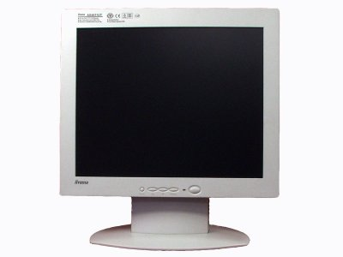
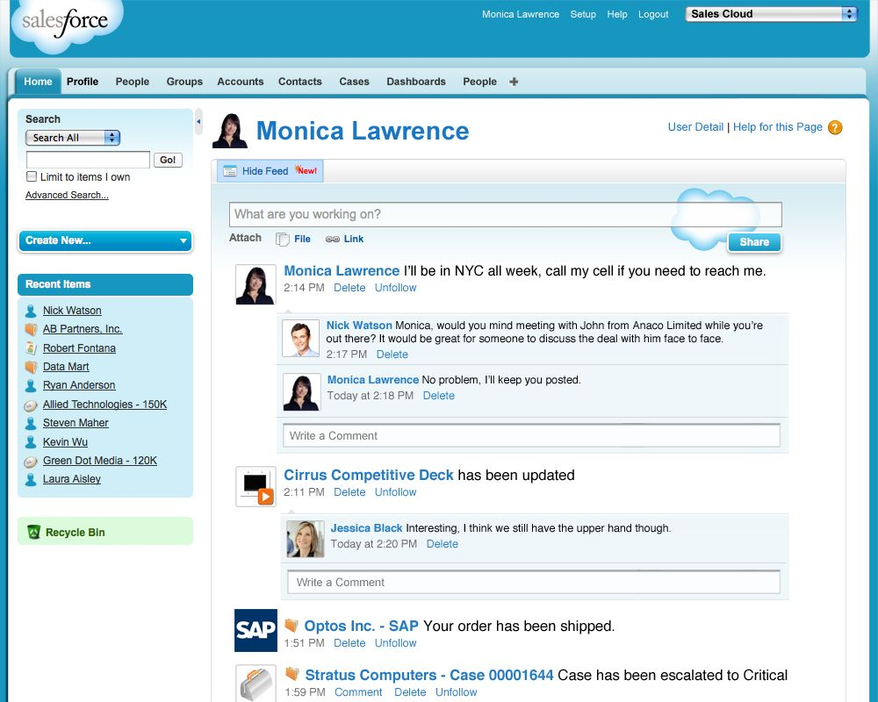

Application Error Handling
List of Internal Errors (“Gacks”)
Bugs Auto-Created and Assigned
ERROR
Error | Desc | Count
Error 1 | Desc 1 | 23
Error 2 | Desc 2 | 53
Error 3 | Desc 3 | 12
… | … | …
Bug | Desc | Assigned
Bug 1 | Desc 1 | Assignee 1
Bug 2 | Desc 2 | Assignee 2
Bug 3 | Desc 3 | Assignee 3
… | … | …
Duplicates suppressed within an instance
Ideally, errors are fixed before customers report them
Notes:
Application code raises internal errors (GACKs)
Cache service maintains recent error list
Duplicates are suppressed within an instance
Gacks evaluated against rules to automatically create bugs
Ideally fix errors before customers report them

Slide 29
Test Hammers
Conduct pre-release testing of with existing customer data
Install and upgrade all platform applications
Run all Apex Code and customer-written unit tests
Customers partner with Salesforce to test releases
New Release
Customer Code and Applications
✓
✓
✓
✓

Slide 30
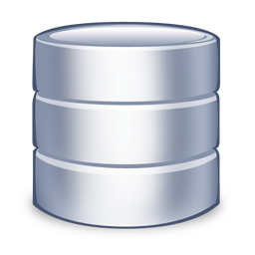

Scrutiny
Tasks that validate data consistency and correctness
  Referential integrity
  Validate denormalized values
  Application data validation
Periodic automatic production runs
  Often run manually for a specific tenant
May optionally fix data
  Requires manual approval
Run automatically during tests

Slide 31
SQL Analyzer
Tenant isolation / security
Performance
  Finds full table scans, inefficient nested loop joins, cartesian joins
  Validates database hints
SQL Analyzer
SQL Query 1…
SQL Query 2…
SQL Query 3…
SQL Query 4…
SQL Query n…
Fail = Bug created
Static analysis on developer check-in
Dynamic analysis during test runs (Catches any runtime-generated SQL)

Slide 32

Pre-checkin tests
Developer check-ins are queued
Successful changelists are committed to source control
Automation promotes changelists between releases
Pre-CheckIn Machines
Automatic validation
  check-in permission, valid reviewer, etc.
Compiles software
Basic validation
  Starting application server
  Verify simple, core functionality (e.g., API calls)
1
2
3

Slide 33
Automatic Test Failure Analysis
Check-In Batch
100,000s of tests run
Test runs dispatched in parallel across machines
Failures assigned to appropriate check-in
Test automation correlates results and logs
Run batches of changes and binary search to fault
“Flapping” tests identified by re-running in clean environment

Slide 34



System Testing
Check-in
Continual Performance Tests
Automated testing on each check-in
Regular large scale load testing
Test
Playback-based testing
Replay production traffic logs against data
Compare new and old release on actual production data skews and volumes
REC
PLAY
Synthetic transactions
Generate custom workloads and data shapes
Automatically catch any performance regressions
Data

Slide 35





