Slide 1
Manageability for Database-as-a-Service (DaaS): Challenges and Opportunities for the Database Community
Volker Markl
Technische Universität Berlin

Slide 2
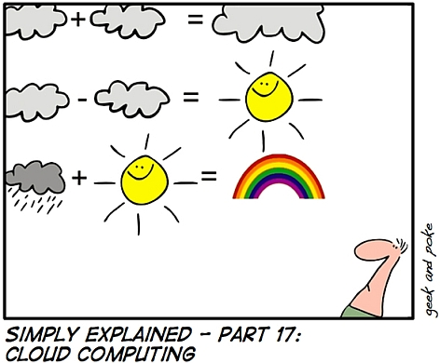
Database as a Service
It is not just about map/reduce and DHTs!
It is not just about providing SQL as a service!
Media Convergence
New data types
Crowd Computing
New form of II

Slide 3
Challenge: Robustness
Fault-tolerance
Long running computations
Large clusters of commodity hardware
Detection and easy replacement of failed components
Processing of black box functions on a non-relational data model
Information extraction
Data mining
Graph data
Audio, Video
Cannot consider queries in isolation
Workload management beyond admission control
Black Swans

Slide 4
Challenge: Data is as elastic as a brick wall
Data Placement and Replication
Where
Data Migration
When
How
Some non-technical problems
Legal
Trust (lineage, security)
Placement must be done automatically at scale, considering legal and trust requirements

Slide 5
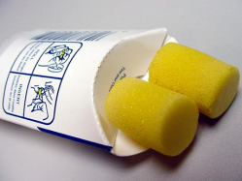
Challenge: Multi-Tenancy @ Scale
Both resource pooling and isolation
Provisioning
Bulk operations
Rolling upgrades

Slide 6
Challenge: Transparency
The user should not (need to) know
where the data is located
where processing takes places
who else is using the system
„service“
The admin needs
simple, scalable system
automation, no knobs

Slide 7
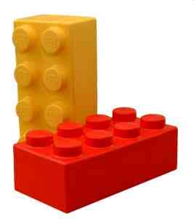
Impact on Self-Managing Research
Tighter integration of planning and processing ⇒ rethink workload management
Automatic data placement and migration ⇒ rethink advisors
Industrialization of operation
assembly of components
⇒ rethink system architecture

Slide 8
In Summary
Robustness is key
Predictability gets harder and harder
Data elasticity is hard to achieve
Can we predict the future from the past ?

